Slide 1

동남아 보험시장 현황 및 시사점
박 상 대
01

Slide 2
Today's agenda
Executive summary
Project overview
Problem
Solution and recommendations
Timeline
Qualifications
Step by step
Mock-up and prototype
Pricing
Terms and conditions
The team
Contact us

Slide 3
03
Executive summary
Presentations are communication tools that can be used as demonstrations, lectures, speeches, reports, and more.
정보담아

Slide 4

04
Project overview
Presentations are communication tools that can be used as demonstrations, lectures, speeches, reports, and more.

Slide 5

정보담아
05
Problem
Presentations are communication tools that can be used as demonstrations, lectures, speeches, reports, and more.

Slide 6
Solution
RECOMMENDATION 1
RECOMMENDATION 2
RECOMMENDATION31
Presentations are communication tools that can be used as lectures.
Presentations are communication tools that can be used as lectures.
Presentations are communication tools that can be used as lectures.

Slide 7

Proposed timeline
PHASE 1
PHASE 2
PHASE 3
Presentations are tools that can be used as lectures.
Presentations are tools that can be used as lectures.
Presentations are tools that can be used as lectures.

Slide 8
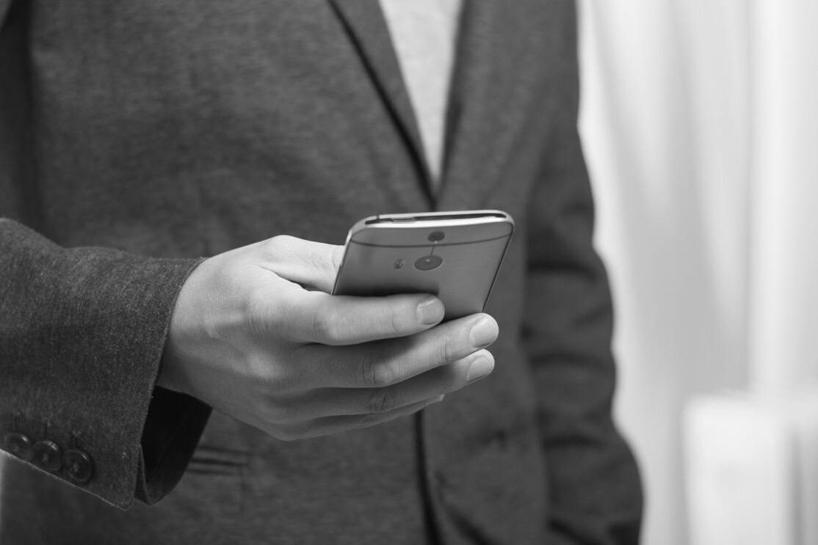
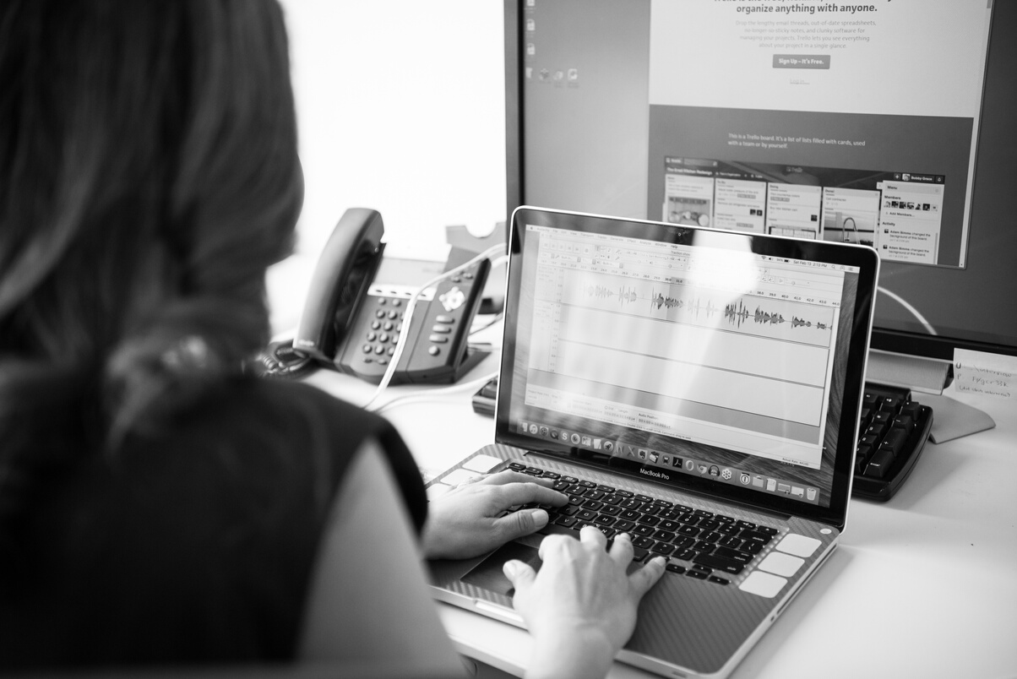

08
STEP 1
Presentations are tools that can be used as lectures.
STEP 2
General steps
Presentations are tools that can be used as lectures.
STEP 3
Presentations are tools that can be used as lectures.
정보담아

Slide 9
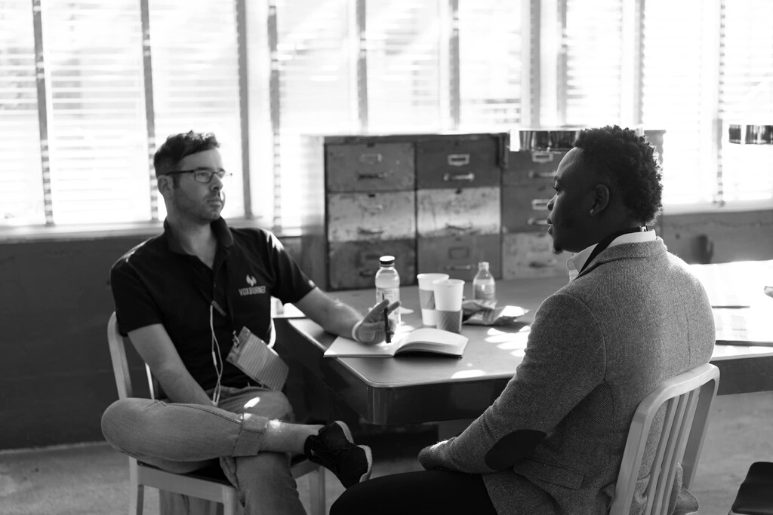


정보담아
09
Mock-up and prototypes
Presentations are communication tools that can be used as lectures.

Slide 10

90%
PROPOSED INCREASE
IN SALES

Slide 11





04
Years of experience
Roster of notable clients
Qualifications
Latest technology
Advanced techniques
Creative input

Slide 12
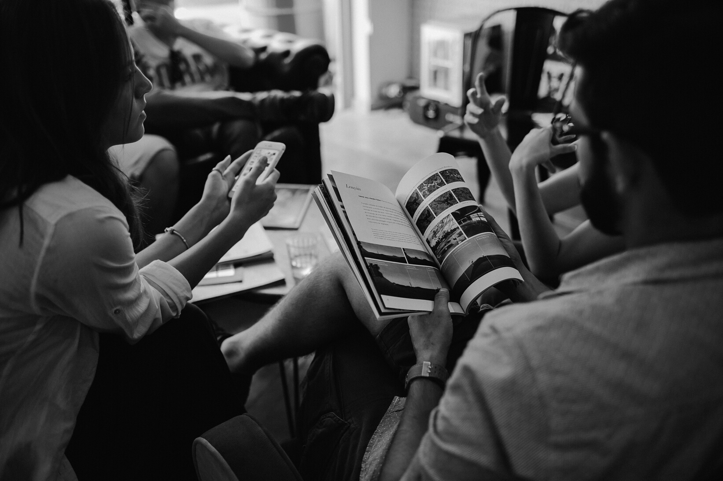
CONSULTATION
12
Presentations are communication tools that can be used as lectures.
PROJECT IMPLEMENTATION
Presentations are communication tools that can be used as lectures.
POST-PROJECT
Presentations are communication tools that can be used as lectures.
Pricing

Slide 13
Terms and conditions
Presentations are communication tools that can be used as demonstrations, lectures, speeches, reports, and more.

Slide 14
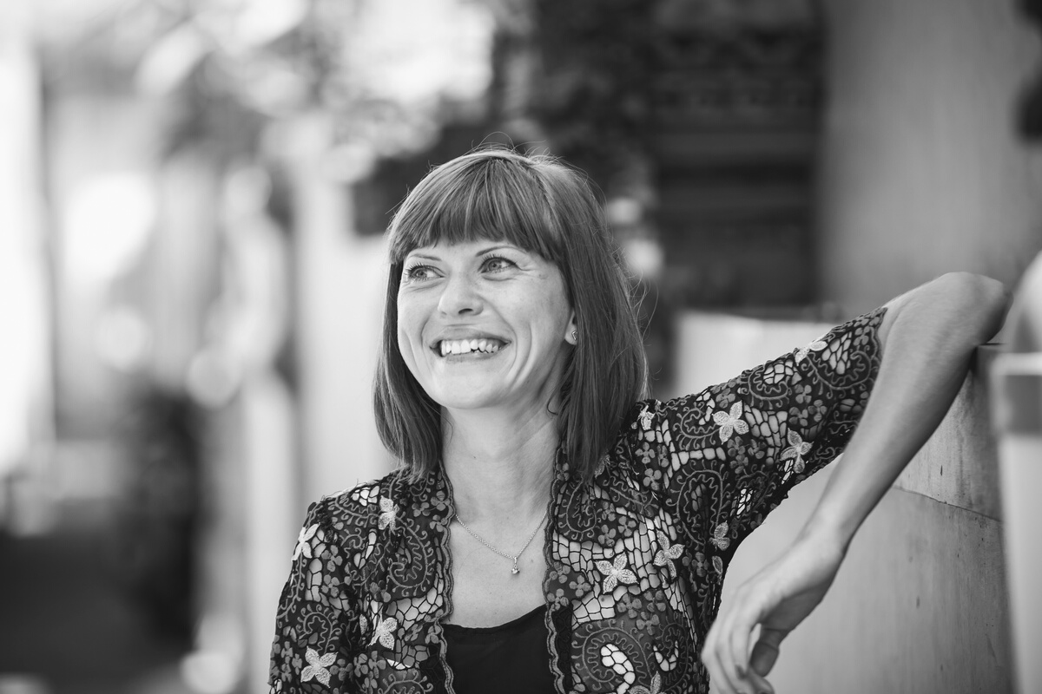
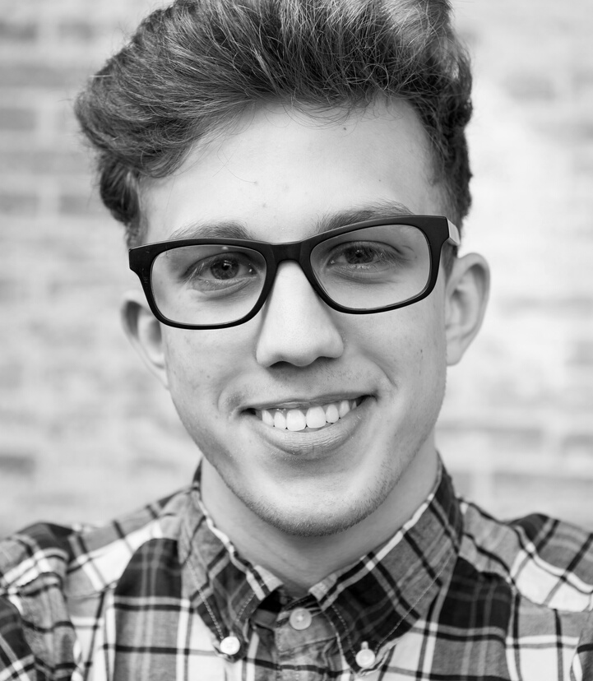
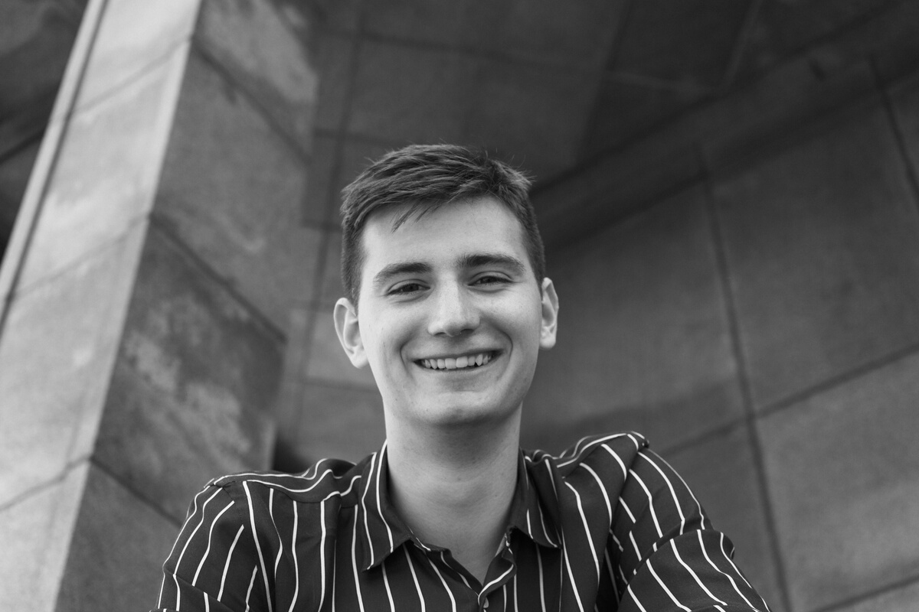
14
ISA MORRIS
President
The team
ALI ROGERS
Creative manager
JAMES BARNES
정보담아
Creative manager

Slide 15
15
MAILING ADDRESS
123 Anywhere St., Any City, State, Country 12345
Contact us
EMAIL ADDRESS
hello@reallygreatsite.com
PHONE NUMBER
123 Anywhere St., Any City, State, Country 12345
정보담아

